Slide 1
INF221 - Web Design & Development: REST
Isaac S. Mwakabira
Notes:
Recap:
Functions

Slide 2
Introductions
Web APIs
URI vs. URL
API – Application Programming Interface, and examples
REST(ful) APIs, and examples

Slide 3
APIs
Communication - focus
Abstraction
Standardized
GraphQL - SOAP
REST - HTTP/HTTPs

Slide 4
APIs vs. SDKs
Standard Dev. Kit (SDK)
Toolbox or code that calls apis for you
Languages: JAVA, PYTHON, etc
Put Diagram Here

Slide 5
URI vs. URL
URI – Universal Resource Identifier
Defined as any character string that identifies a resource on a particular server over the HTTP/s protocol
URL – Unified Resource Locator
Specific type of URI
Locates an existing RESOURCE on the internet, the client (browser or tools like POSTMAN) makes a request to a server for the resource over HTTP/s protocol.
Defined as URIs that identify a resource by its location or by the means used to access it, rather than by a name or other attribute of the resource.
Resource – uniquely identifiable object on the internet

Slide 6
URI vs. URL…
General definition
scheme://host[:port#]/path/.../[;url-params][?query-string][#anchor]
Example:
http://127.0.0.1:80/api/users
https://127.0.0.1:80/api/users
https://www.cc.ac.mw/people/students
https://41.70.32.5/people/students

Slide 7
URI vs. URL…
Parts of URL for HTTP/s protocol
Scheme – identifies the protocol used to access the resource on the Internet. Can be HTTP (without SSL) or HTTPS (with SSL)
Host – identifies where the resource is held, the host that holds the resource
Path - identifies the specific resource in the host that the web client wants to access.
Query string - provides a string of information that the resource can use. usually a string of name and value pairs ie. term=john
Name and value pairs are separated by an ampersand (&).
i.e. term=John&sort=DESC&limit=12
Anchor – identifies a fragment in a page resource i.e. especially if a resource is a web page
https://martinfowler.com/articles/richardsonMaturityModel.html#level1

Slide 8
API – Application Programming Interfaces
Contract provided from one piece of software to another
Structured request and response
Relies on stateless, client-server protocol, almost always HTTP
Treats server objects as resources that can be created, updated or destroyed
Can be used by virtually any programming language
Node (JS), Spring or Spring-boot (Java or Kotlin), .NET Framework (C#), Laravel (PHP)

Slide 9
RESTful APIs
Representational State Transfer
Architecture style for designing networked applications
Describes design constraints that define the HTTP protocol
Design Constraints. Discuss?
Addressability – unique & stable resource identifiers
Uniform Interface – resource interaction is through a uniform interaction provided by GET, POST, PATCH, DELETE, OPTIONS, HEAD
Stateless Interactions – client/server permanent sessions are not established to span multiple interactions
Self-Describing Messages – responses and requests contain both data and meta-data(description/information about data)
Hypermedia – relationship between resources

Slide 10
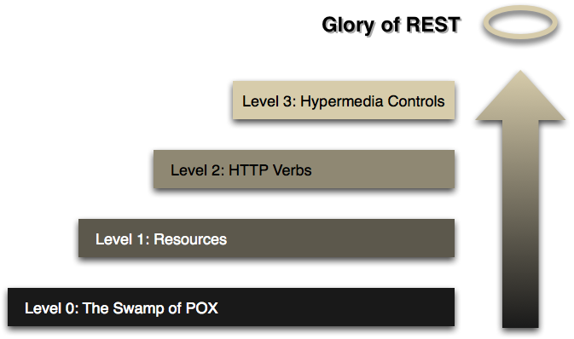
RESTful APIs
Maturity Model. Discuss?
Is every API RESTful?
Steps towards REST

Slide 11
REST resources
A resource is an object with a type, associated data, relation to other resources and a set of methods that operate on it.
Similar to object instances in object-oriented programming.
Each resource has its own address or URI—every interesting piece of information the server can provide is exposed as a resource.
In deciding what resources are within your system, name them as nouns.
RESTful URI should refer to a resource that is a thing instead of referring to an action.
Nouns have properties as verbs do not

Slide 12
Endpoint
Addresses/identifies a unique resource
The URI/URL where api/service can be accessed by a client application

Slide 13
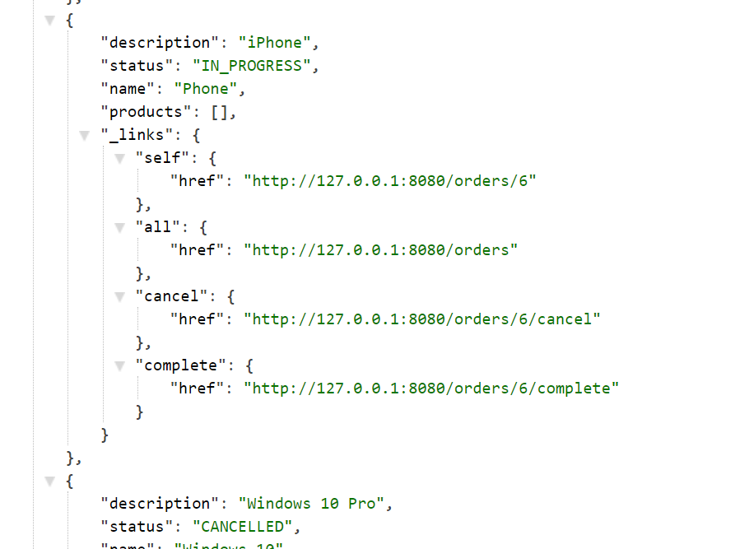
Hypermedia
HATEOAS
HyperText As The Engine Of Application State

Slide 14
HTTP Verbs
The HTTP verbs comprise a major portion of our “uniform interface” constraint and provide us the action counterpart to the noun-based resource

Slide 15
HTTP Verbs (CRUD)
GET: Retrieve data from specified resource
POST: Submit data to be processed to a specified resource
PUT: Update a specified resource
DELETE: delete a specified resource
HEAD: same as GET but does not return body
OPTIONS: Returns the supported HTTP methods
PATCH: Update partial resources

Slide 16
GET verb
The HTTP GET method is used to retrieve (or read) a representation of a resource.
Returns a representation in XML or JSON.
Examples:
GET http://www.example.com/customers/12345
GET http://www.example.com/customers/12345/orders
GET http://www.example.com/buckets/sample
According to the design of the HTTP specification, GET (along with HEAD) requests are used only to read data and not change it. Therefore, when used this way, they are considered safe.

Slide 17
PUT verb
Most-often utilized for update capabilities.
Examples:
PUT http://www.example.com/customers/12345
PUT http://www.example.com/customers/12345/orders/98765
PUT http://www.example.com/buckets/sample
PUT is not a safe operation, in that it modifies (or creates) state on the server,

Slide 18
POST verb
Most-often utilized for update capabilities.
Examples:
POST http://www.example.com/customers
POST http://www.example.com/customers/12345/orders
POST is neither safe or idempotent.

Slide 19
DELETE verb
It is used to delete a resource identified by a URI.
Examples:
DELETE http://www.example.com/customers/12345
DELETE http://www.example.com/customers/12345/orders
DELETE http://www.example.com/buckets/sample
DELETE is NOT safe.

Slide 20
Tools
Postman – stand alone application
JSON editor – broswer extension or as stand alone app
Browser
CURL

Slide 21
Summary
URI vs. URL
API – Application Programming Interface
REST(ful) APIs, and examples

Slide 22
References
https://dl.acm.org/doi/10.1145/514183.514185
https://martinfowler.com/articles/richardsonMaturityModel.html
Pautasso C. (2014) RESTful Web Services: Principles, Patterns, Emerging Technologies. In: Bouguettaya A., Sheng Q., Daniel F. (eds) Web Services Foundations. Springer, New York, NY. https://doi.org/10.1007/978-1-4614-7518-7_2

